Slide 1
System Analysis and Design
Course Introduction
An Overview of System Analysis and Design
School of Software Engineering, Tongji University

Slide 2
Index
Course Overview
Assessment
Tools and Environments
Main topics
Overview of System Analysis and Design
Needs on analysis and design
Major Roles
Development Process
Establishing System Perspective
What to model: A System Vision
Visual Modeling Examples

Slide 3
Course Overview
This course covers the essential skills of system analysis and design including requirements analysis, use case modeling, design principles, architecture design, object-oriented design and domain driven design.
It emphases the ever changing nature of software requirements and key analysis and design techniques to identify and handle those changes.
Both Object-Oriented Methodologies and Agile Approaches are introduced.
Best practices in Software System Architecting, Design and Development will be discussed.
How to apply analysis and design principles and techniques with iterative development will be demonstrated in this course.

Slide 4
Assessment
Attendance, 10%
Team Project (no more than 5 members), 90%
Project vision, scope and essential requirements will be released in Week 3.
Software Requirements Specification; 30%
Analysis Model and Middle-Term presentation; 30%
Design Model, Final presentation and qualities of final deliveries; 30%
Notes:
http://rome2rio.com

Slide 5





Reference Books
Many online resources…
Notes:
ISBN：9787111499374

Slide 6
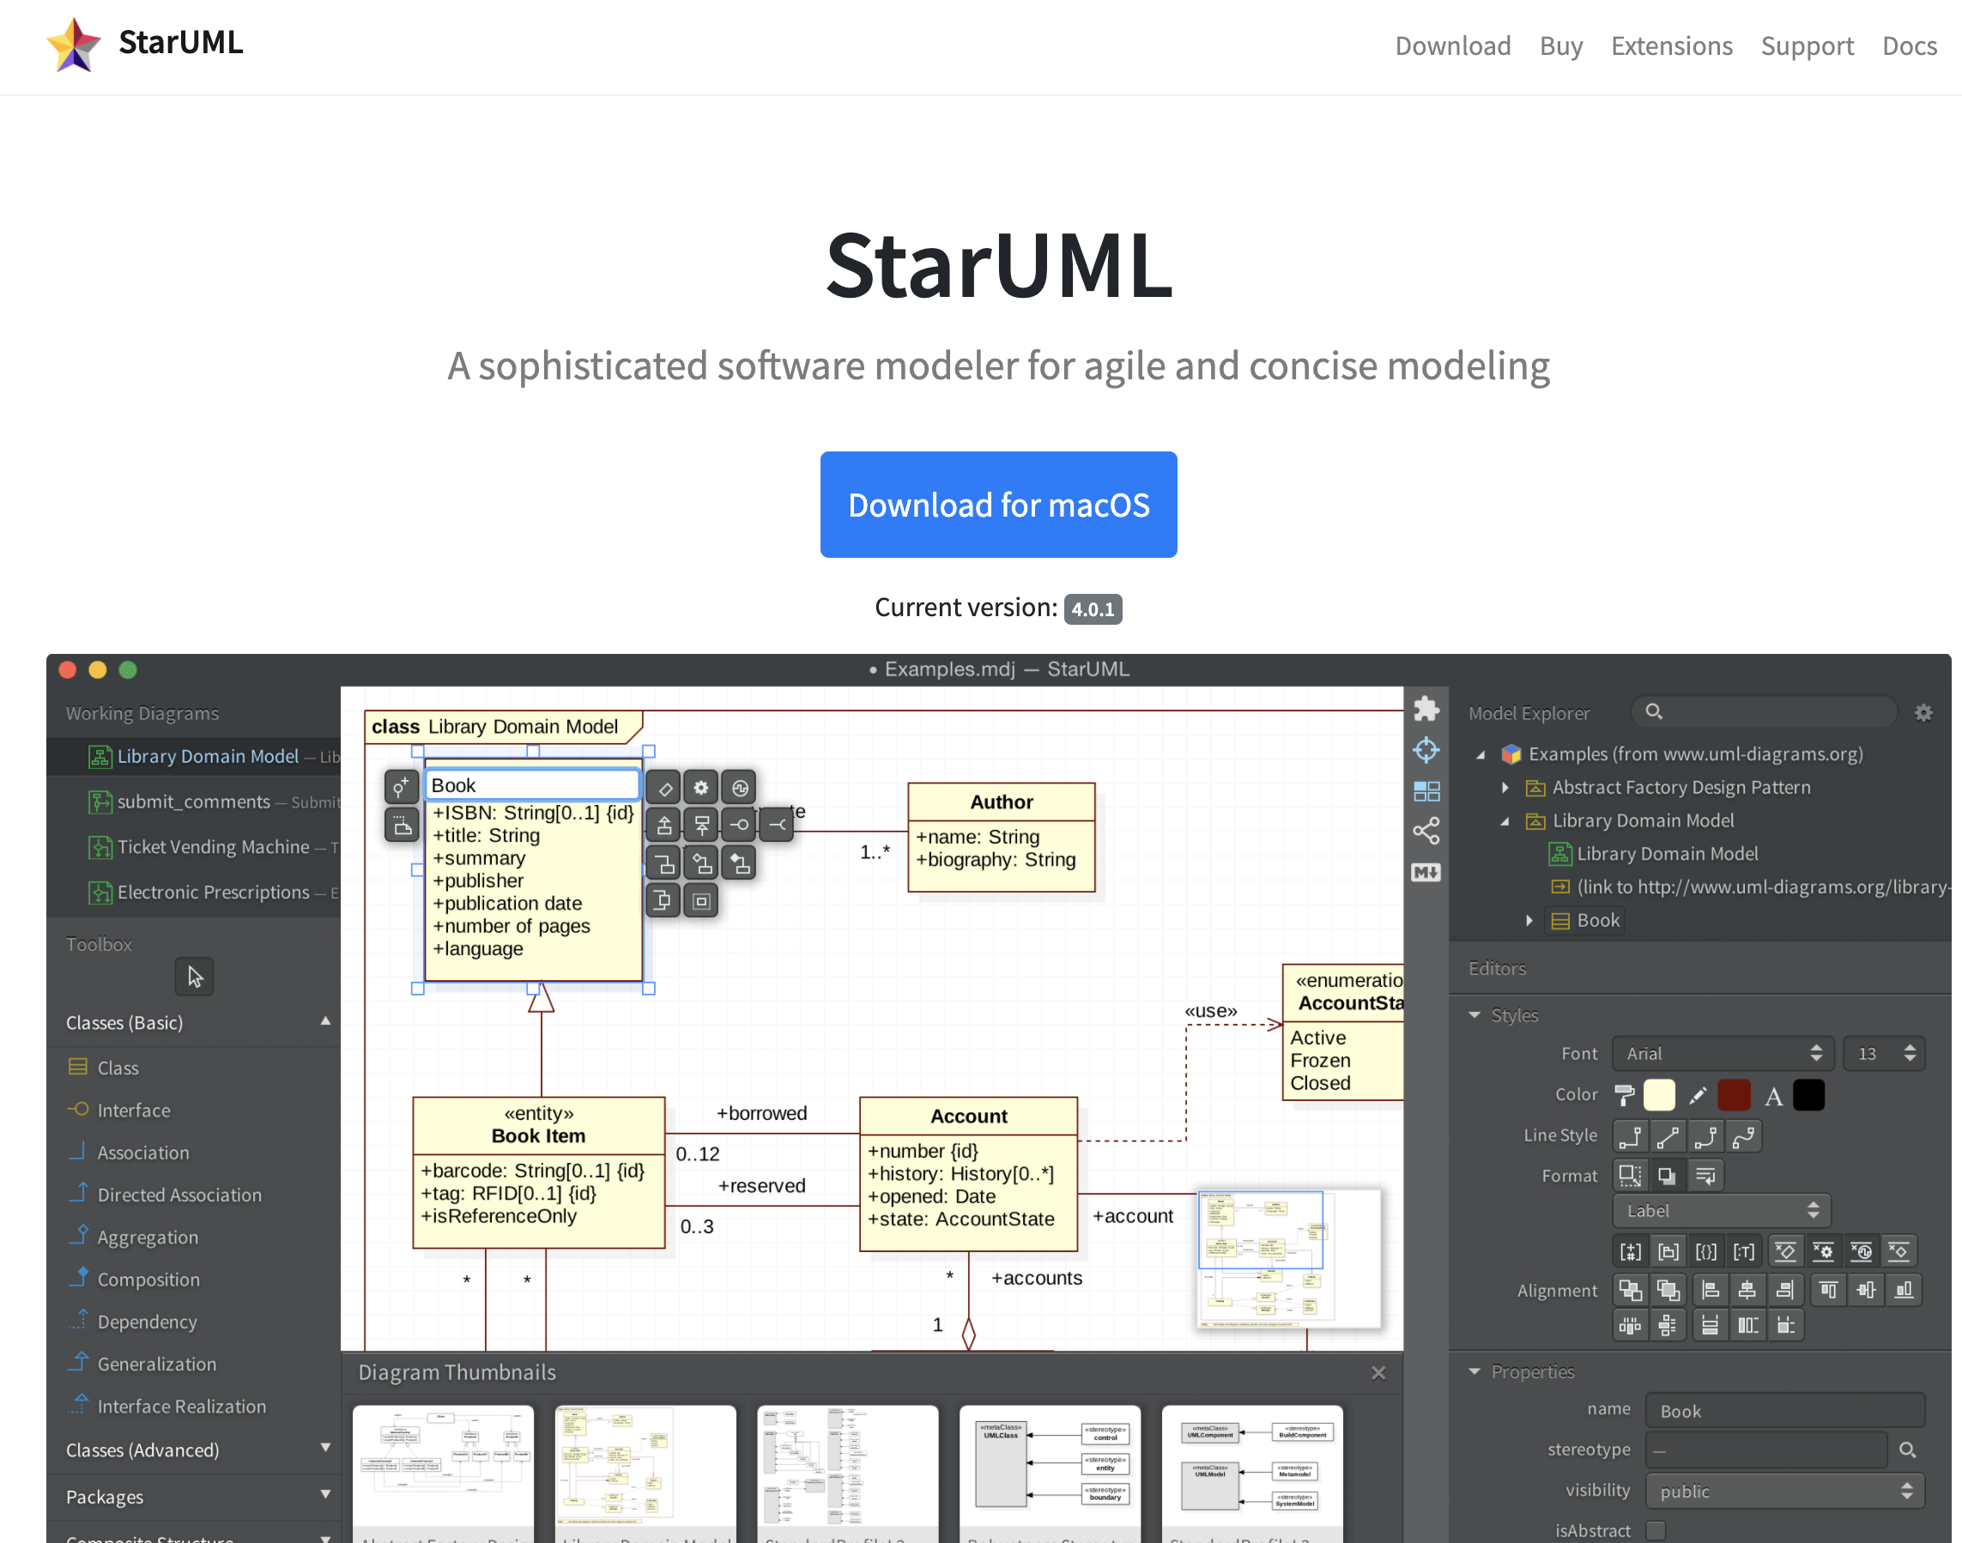

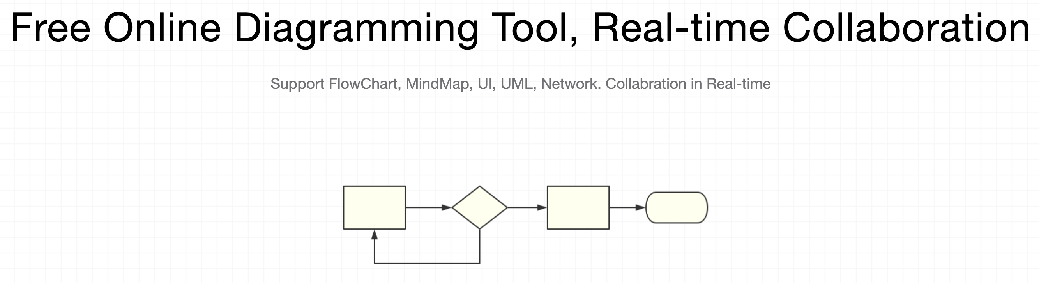




Modeling Tools and Collaboration Environments
https://staruml.io/
Draw.io
Many online team collaboration tools are also useful for this course

Slide 7
Lecture Topics (1)
Course introduction & An Overview of System Analysis and Design
Project Management and Information Requirements Analysis
OOAD, UP and UML
Requirements Analysis and Use Case Modeling
Agile Modeling
Moving into Design (SRS Due)
Preliminary Architecture Design
Refining the Design
Design Principles
Notes:
http://rome2rio.com

Slide 8
Lecture Topics (2)
Middle-Term Presentation
Architecture Styles and Patterns
Managing Implementation
Domain Driven Design: Strategic Design and Tactical Design
Embracing New Technology
Discussion and Review
Final Presentation 1
Final Presentation 2
Notes:
http://rome2rio.com

Slide 9
Office Hours
Tuesday, 13:00~15:00, Jishi Building, Room 412
TA: to be announced…

Slide 10
Share Your Experiences
What programming languages can you work with? Please describe your experience with them.
What’s the most challenging thing about working as a programmer?
What’s your current understanding of system analysis and design?
Think – Pair –Share…

Slide 11
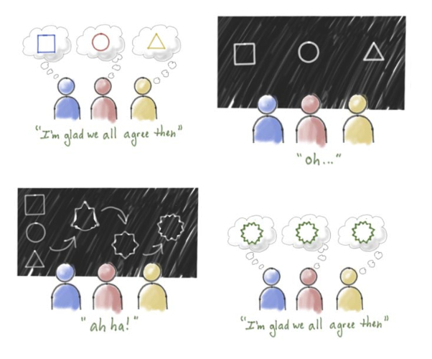
Needs for System Analysis and Design
Delivering a system without proper planning leads to great user dissatisfaction and frequently causes the system to fall into disuse
Lends structure to the analysis and design of information systems
A series of processes systematically undertaken to improve a business through the use of computerized information systems
Cartoon by Barrett illustrating the importance of shared understanding

Slide 12
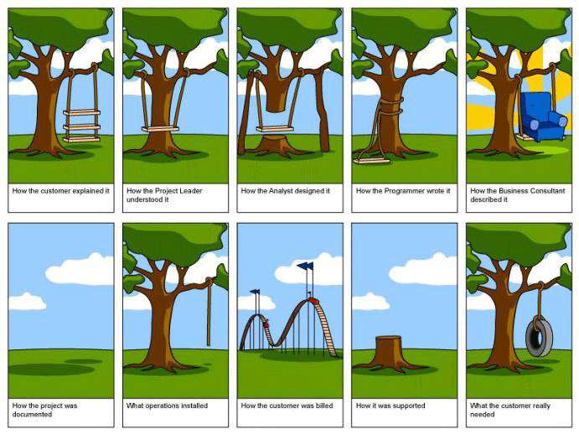
Comic : Software Development Process
Notes:
“Great Software Debates”, Alan M. Davis states in the chapter “Requirements”, subchapter “The Missing Piece of Software Development”:
“ Students of engineering learn engineering and are rarely exposed to finance or marketing. Students of marketing learn marketing and are rarely exposed to finance or engineering. Most of us become specialists in just one area. To complicate matters, few of us meet interdisciplinary people in the workforce, so there are few roles to mimic. Yet, software product planning is critical to the development success and absolutely requires knowledge of multiple disciplines.”

Slide 13
Roles of a Systems Analyst
The analyst must be able to work with people of all descriptions and be experienced in working with computers
Three primary roles:
Consultant
Supporting expert
Agent of change
Qualities
Problem solver
Communicator
Strong personal and professional ethics
Self-disciplined and self-motivated
Notes:
The successful systems analyst must possess a wide range of qualities.
Problem solver—views the analysis of problems as a challenge and enjoys devising workable solutions.
Communicator—capable of relating meaningfully to other people over extended periods over time. Need enough computer experience to program, to understand the capabilities of computers, glean information requirements from users, and communicate what is needed to programmers.
Strong personal and professional ethics—need to shape their client relationships
Self-disciplined and self-motivated—must be able to coordinate other people as well as innumerable project resources.

Slide 14
Software Architect
requirements
solutions
client,
user
architect
developers
assess
creates
assess
visualize
prescribe
appearance,
behavior
architectural design
construction,
cooperation
A successful architect must stand on three “legs”:
Skill: The foundation for practicing architects. It requires knowledge and the ability to apply it to solve real problems.
Impact: The measure of how well an architect applies his or her skill to benefit the company.
Leadership: Determines whether an architect advances the state of the practice.

Slide 15
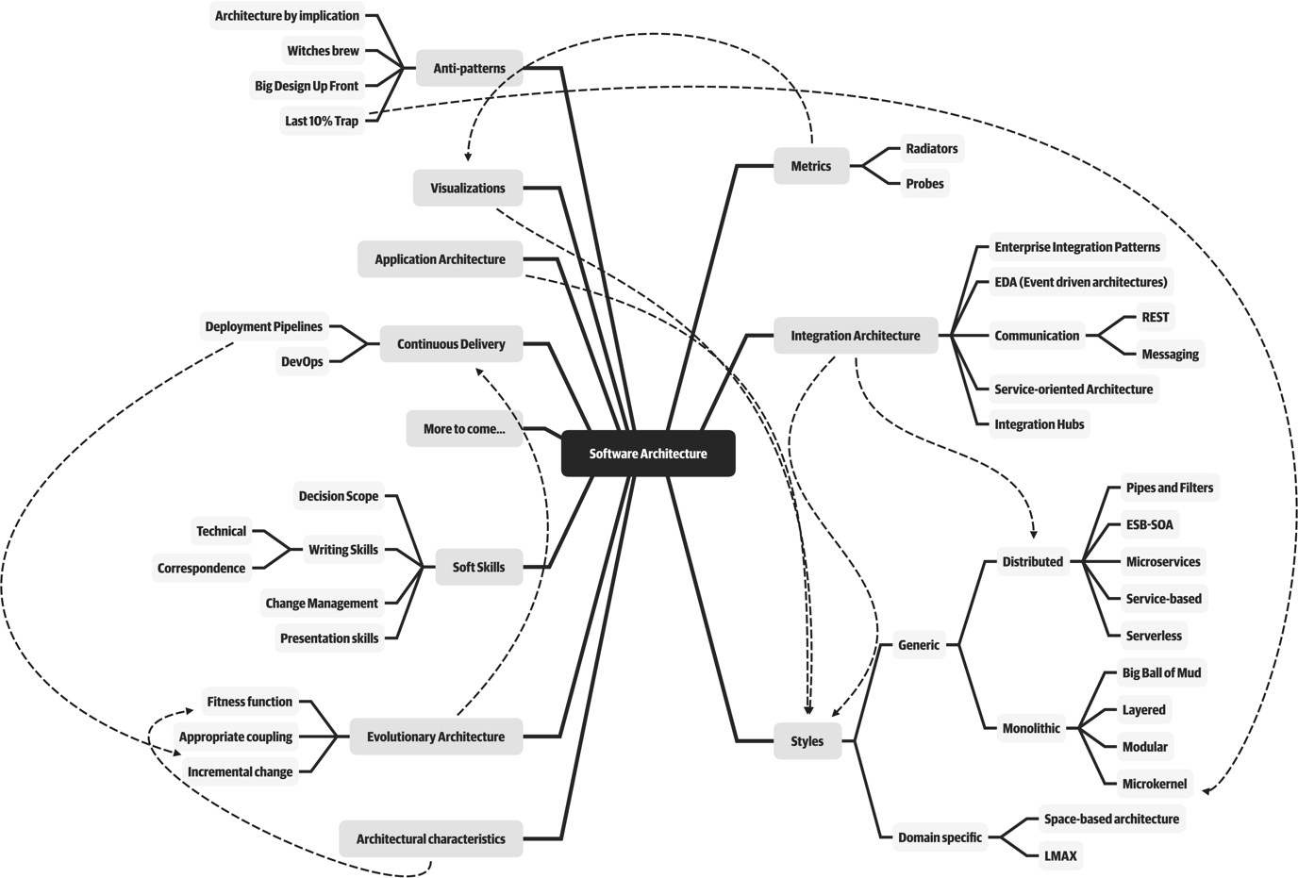
Architecture is about the important stuff…whatever that is. Ralph Johnson

Slide 16
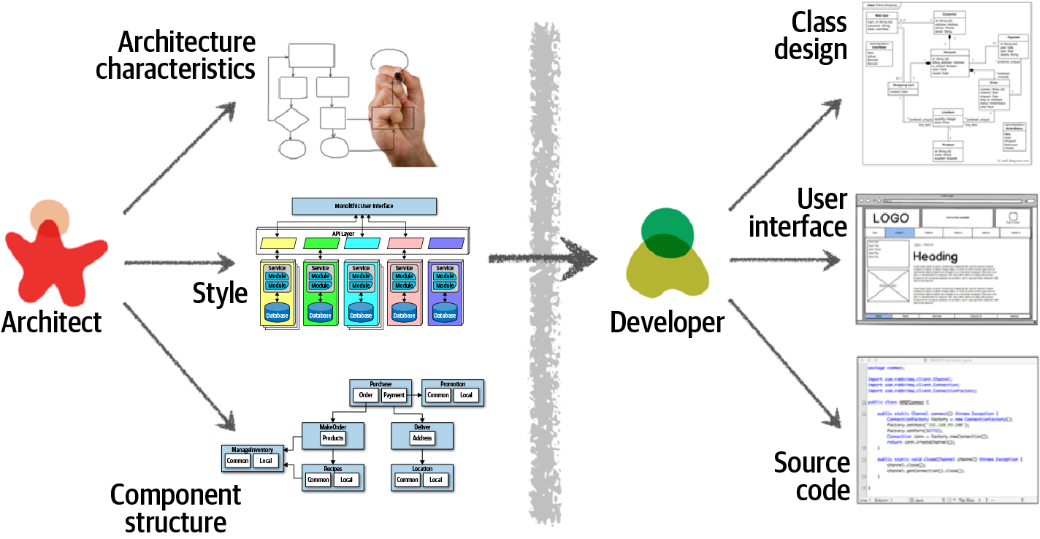
Architecture Versus Design
Traditional view of architecture versus design

Slide 17
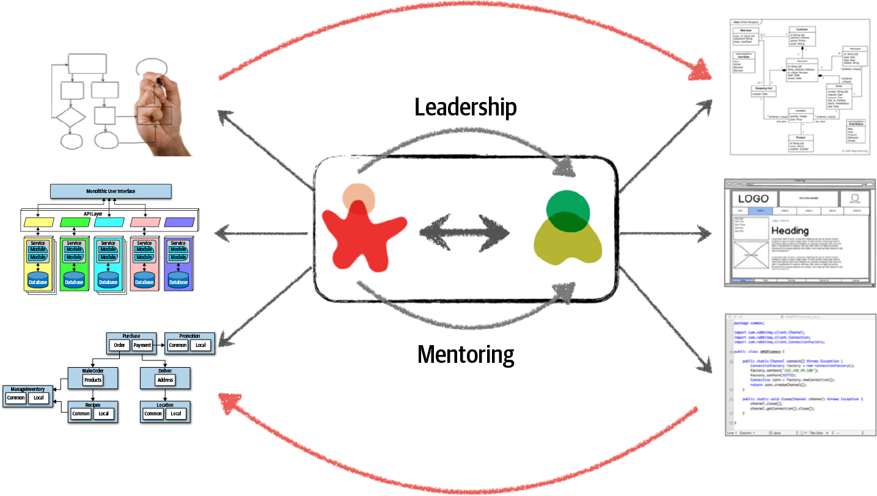
Making Architecture Work Through Collaboration

Slide 18
System Development Life Cycle(SDLC)
The systems development life cycle is a phased approach to solving business problems
Developed through the use of a specific cycle of analyst and user activities
Each phase has unique user activities
The Seven Phases of the Systems Development Life Cycle

Slide 19
Resource Consumption over the System Lifecycle
Eventually maintenance exceeds the cost of a creating a new system.
At that point a new systems study should be untaken.

Slide 20
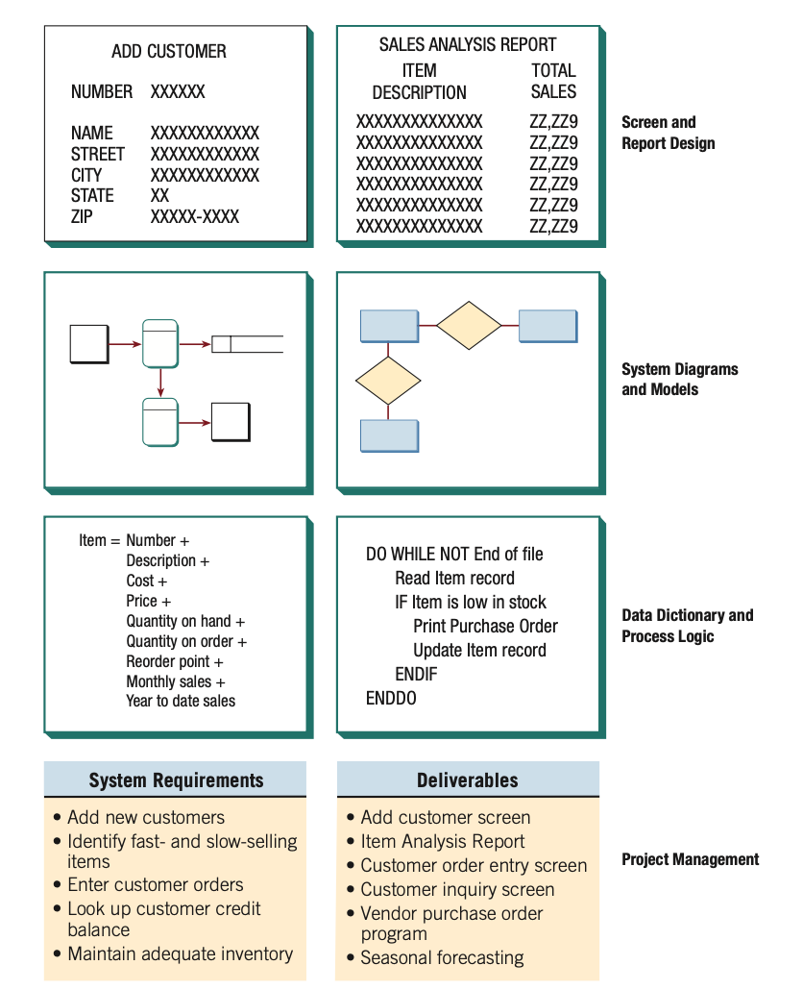
Using CASE Tools
CASE tools are productivity tools for systems analysts that have been created explicitly to improve their routine work through the use of automated support

Slide 21
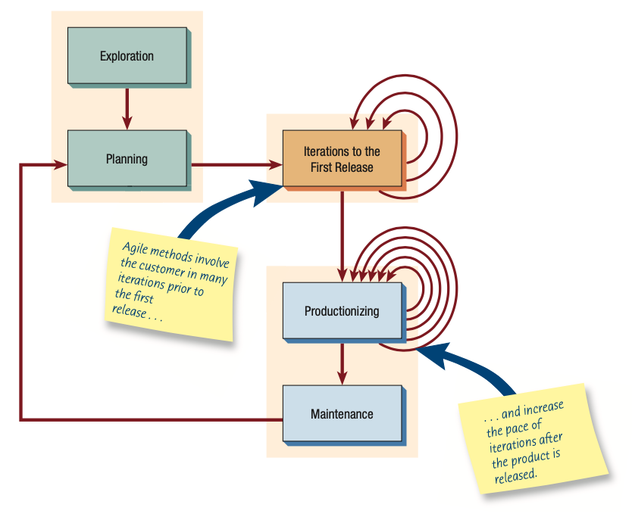
The Agile Approach
Based on
Values
Communication
Simplicity
Feedback
Courage
Principles
Core Practices
Five Stages
Exploration
Planning
Iterations to the first release
Productionizing
Maintenance

Slide 22
Object-Oriented Systems Analysis and Design
Alternate approach to the structured approach of the SDLC that is intended to facilitate the development of systems that change rapidly in response to dynamic business environments
Analysis is performed on a small part of the system followed by design and implementation
The cycle repeats with analysis, design, and implementation of the next part and this repeats until the project is complete
Examines the objects of a system

Slide 23
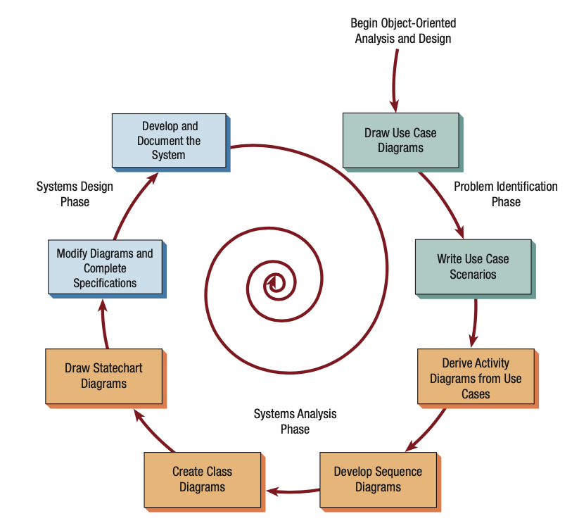
The Typical Steps in OOAD with UML

Slide 24
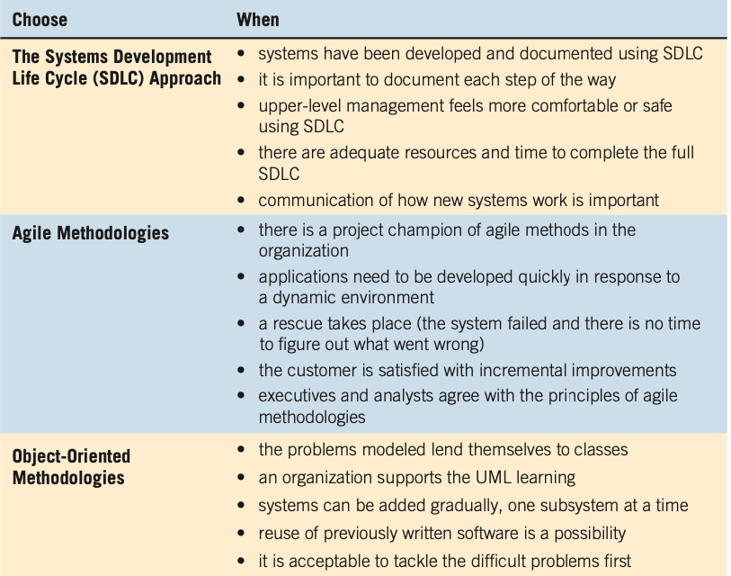
Choosing Which System Development Method to Use

Slide 25
Open Source Software
Four Types of open source communities
Ad hoc
Standardized
Organized
Commercial
Dimensions that differentiate open source communities
General structure
Environment
Goals
Methods
User community
Licensing

Slide 26
Paricipate in Open Source Communities
Rapidity with which new software can be developed and tested
Faster to have a committed group of experts develop, test, and debug code
This fosters creativity
Have many good minds work with innovative applications
Curiosity about software benefits
Achieve collective design
Incorporate open source software design into:
Proprietary products
Processes
Knowledge
IT artifacts

Slide 27
Organizations as Systems
Conceptualized as systems designed to accomplish predetermined goals and objectives
Composed of smaller, interrelated systems serving specialized functions
Specialized functions are reintegrated to form an effective organizational whole
All systems and subsystems are interrelated and interdependent
All systems process inputs from their environments
All systems are contained by boundaries separating them from their environments
System feedback for planning and control
An ideal system self-corrects or self-regulates itself.

Slide 28
System Outputs Serve as Feedback that Compares Performance with Goals

Slide 29
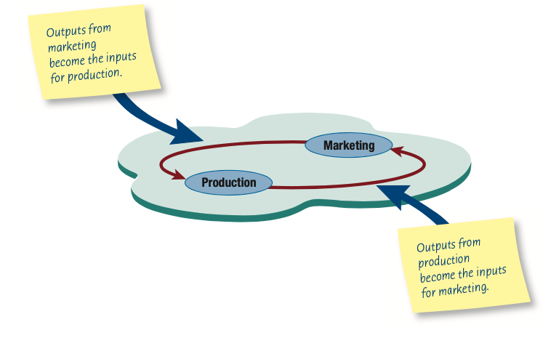
Taking a Systems Perspective
Allows system analyst to understand businesses before they begin their tasks
It is important that members of subsystems realize that they are interrelated with other subsystems
Problems occur when each manager thinks that his/her department is the most important
Bigger problems may occur when that manager rises through the ranks

Slide 30
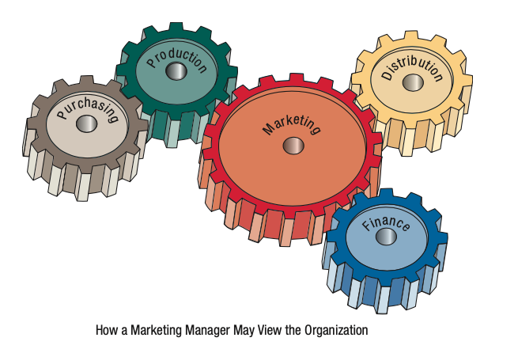
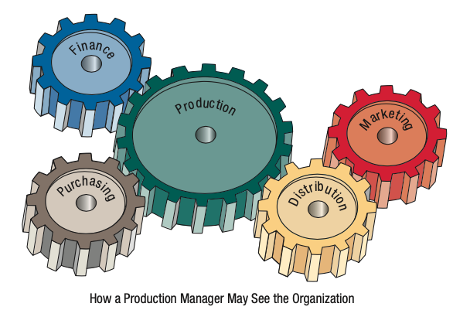
Perpective of Functional Managers

Slide 31
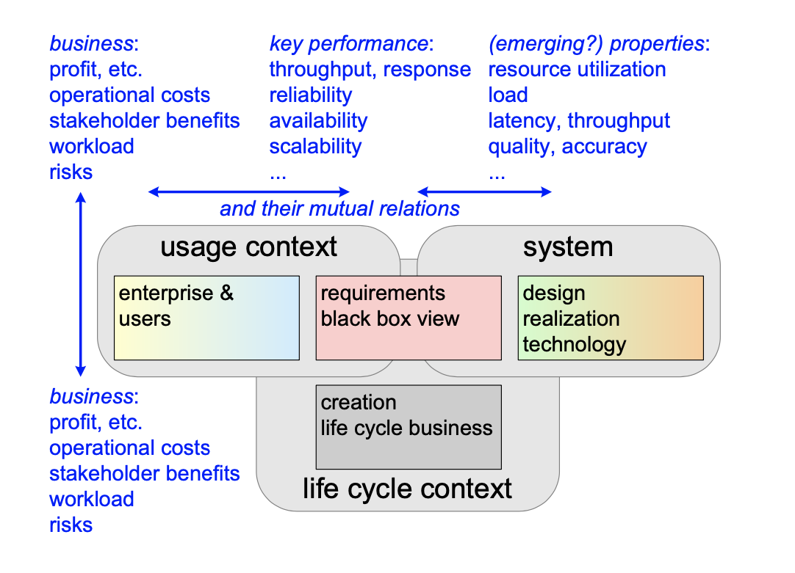
What to Model? A System Vision
References: https://www.gaudisite.nl/SystemModelingAndAnalysisBook.pdf

Slide 32
Visual Modeling: Depicting Systems Graphically
Context-level data flow diagrams
Entity-relationship model
UML
SysML
https://sysml.org/
https://github.com/Systems-Modeling/SysML-v2-Release
ArchiMate
https://pubs.opengroup.org/architecture/archimate3-doc/toc.html
https://www.archimatetool.com/
The C4 Model: Conext, Container, Components, and Code
https://c4model.com/
BPMN
https://www.bpmn.org/
Context Map
https://contextmapper.org/
…

Slide 33
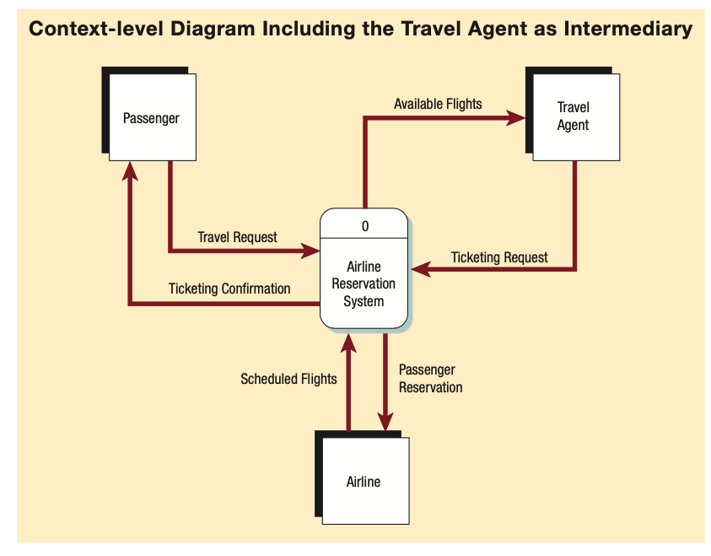
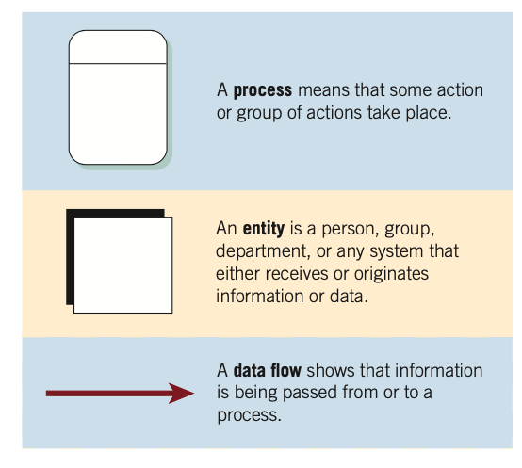
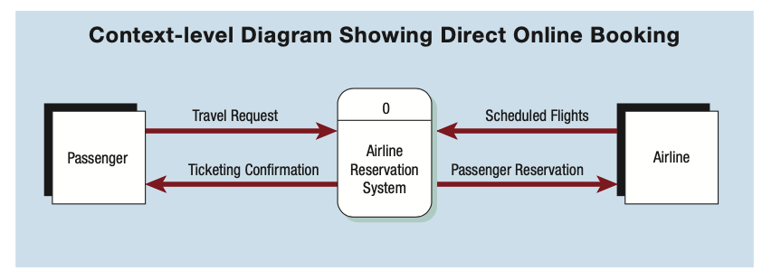
Examples: Context-level data flow diagram

Slide 34
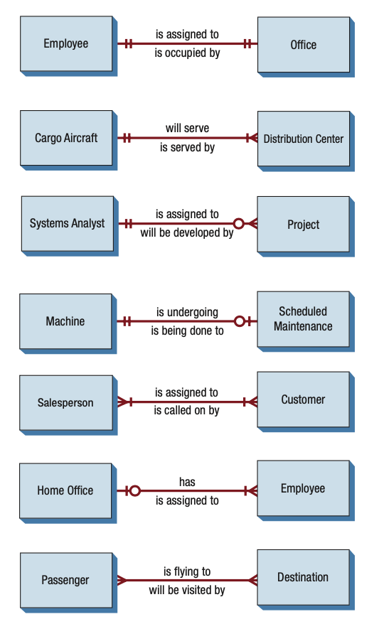
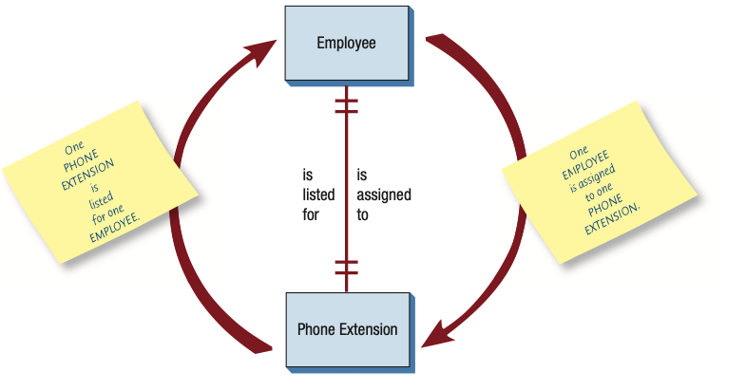
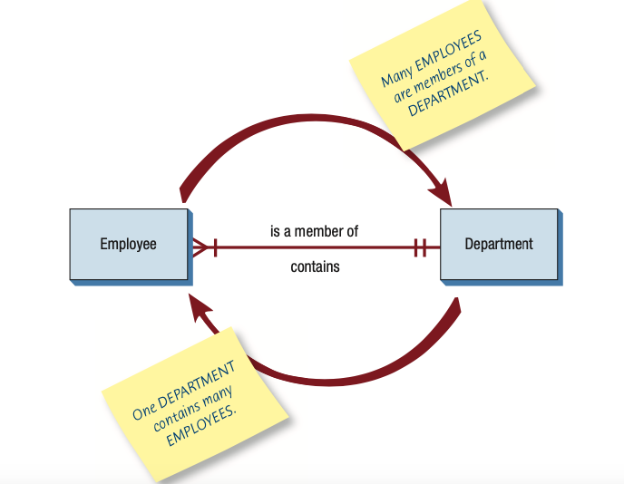
Examples: E-R Diagram

Slide 35
Example: Use Case Diagram
View Report Card
Course Catalog
Maintain Professor
Information
Register for Courses
Student
Login
Maintain Student
Information
Registrar
Select Courses to
Teach
Close Registration
Professor
Submit Grades
Billing System

Slide 36
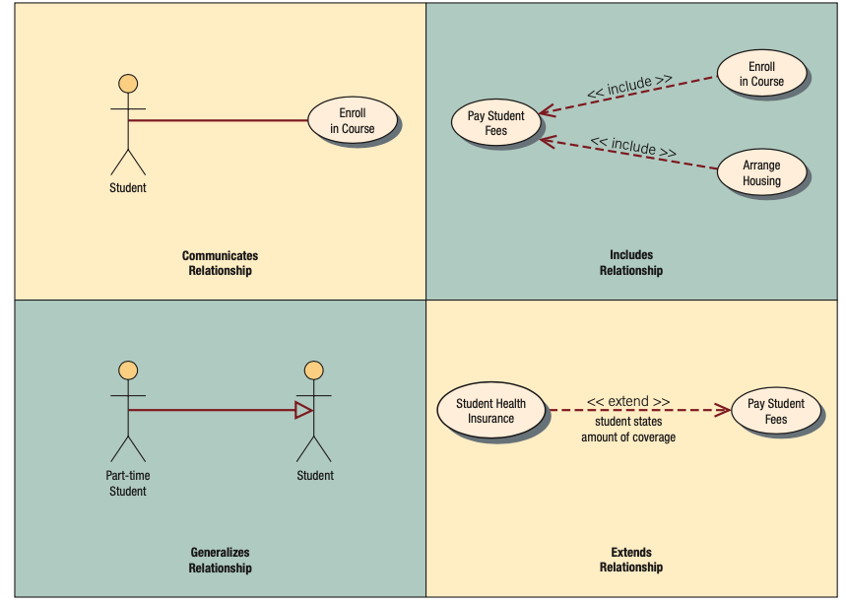
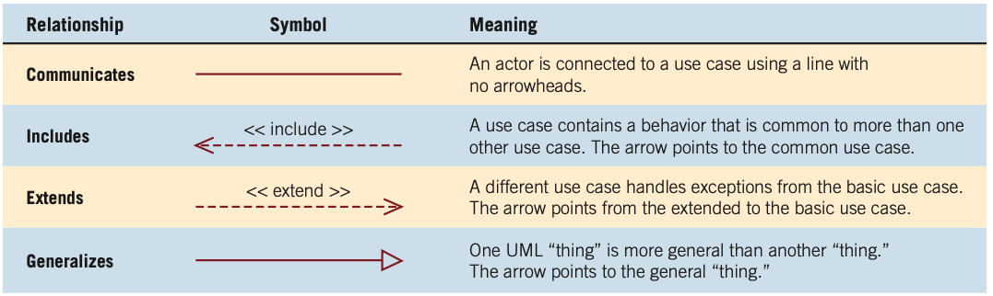
Four Types of Behavioral Relationships in Use Case Diagram
Examples

Slide 37
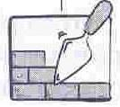
UML Relationships
More examples will be available in later lectures.
Relationships
Association
Dependency
Generalization
Realization
UML Relationships and their graphical representation

Slide 38
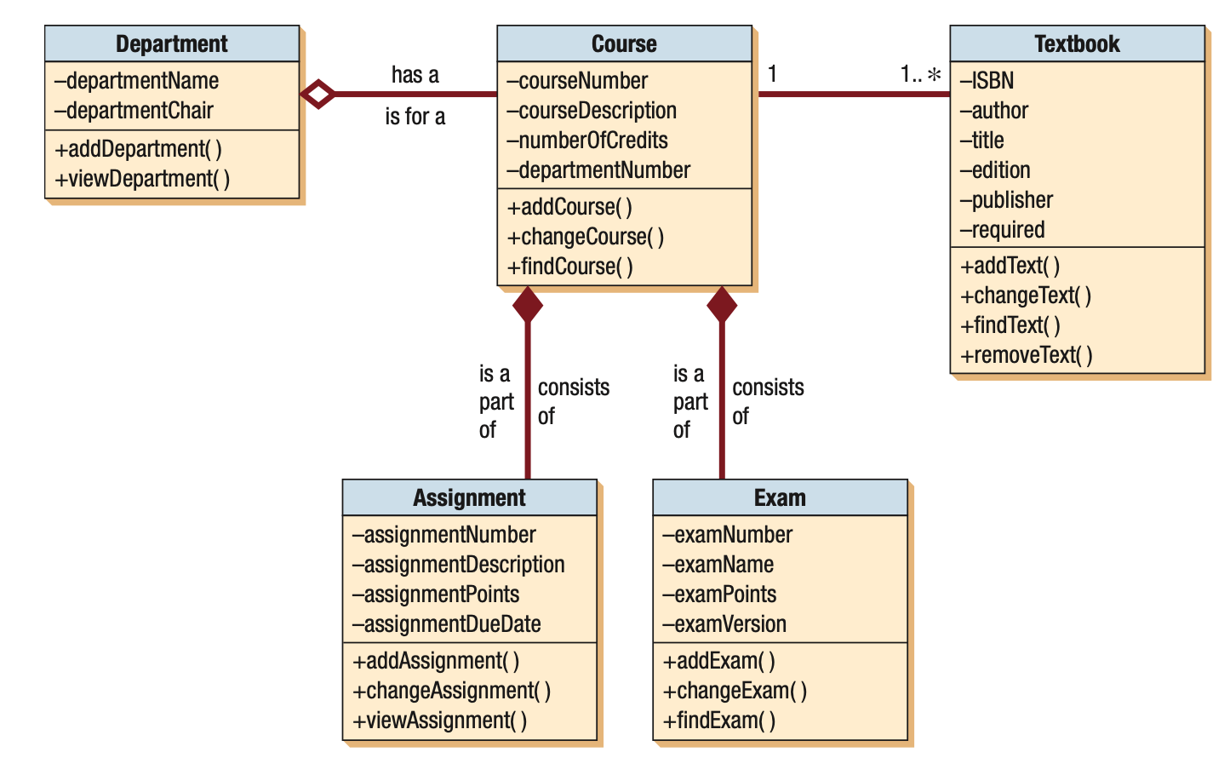
Example: UML Class Diagram

Slide 39
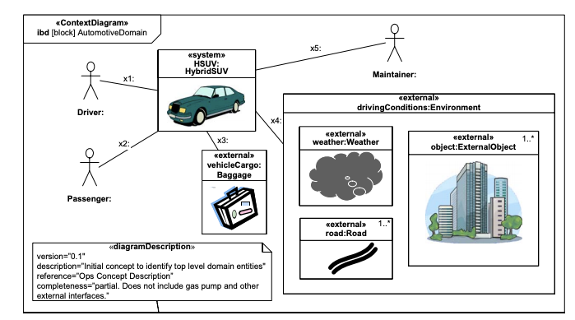
Example: SysML Internal Block Diagram - Setting Context

Slide 40
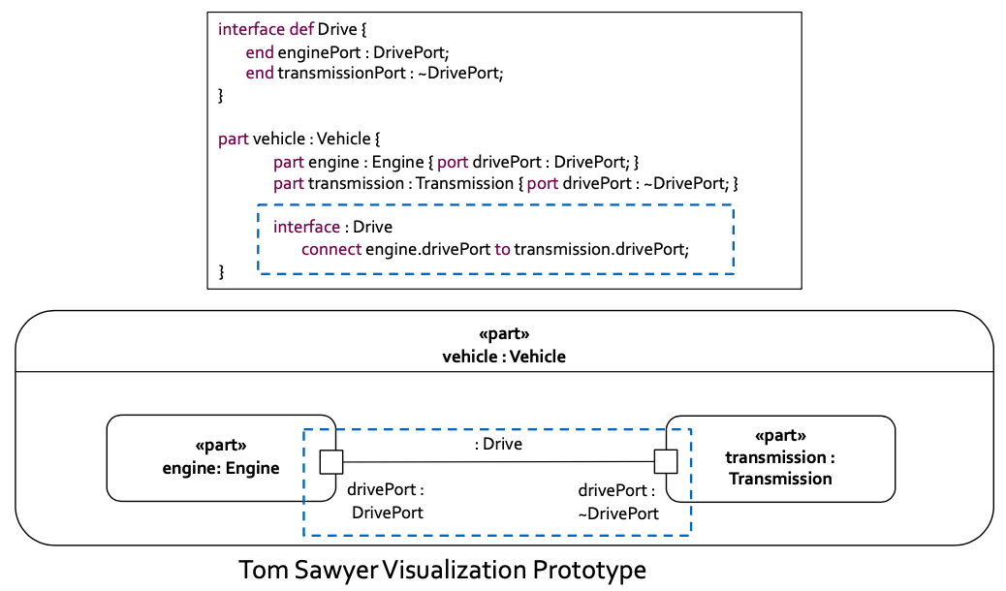
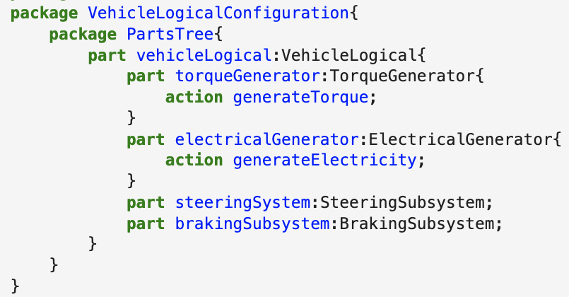
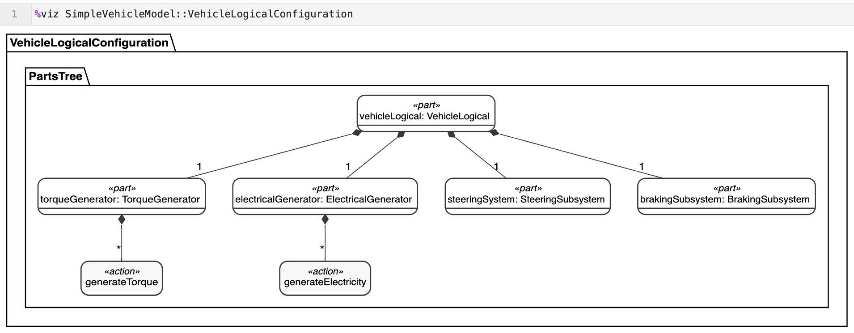
Example: SysML V2

Slide 41
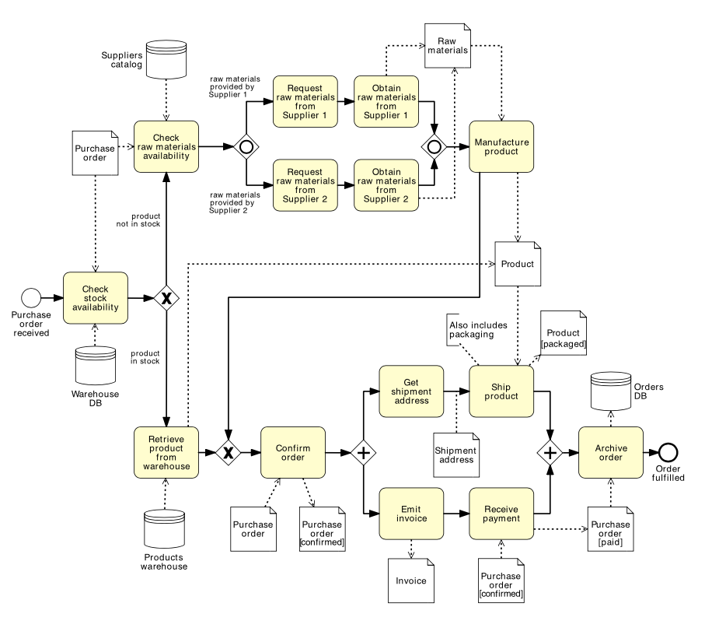
Example: BPMN

Slide 42
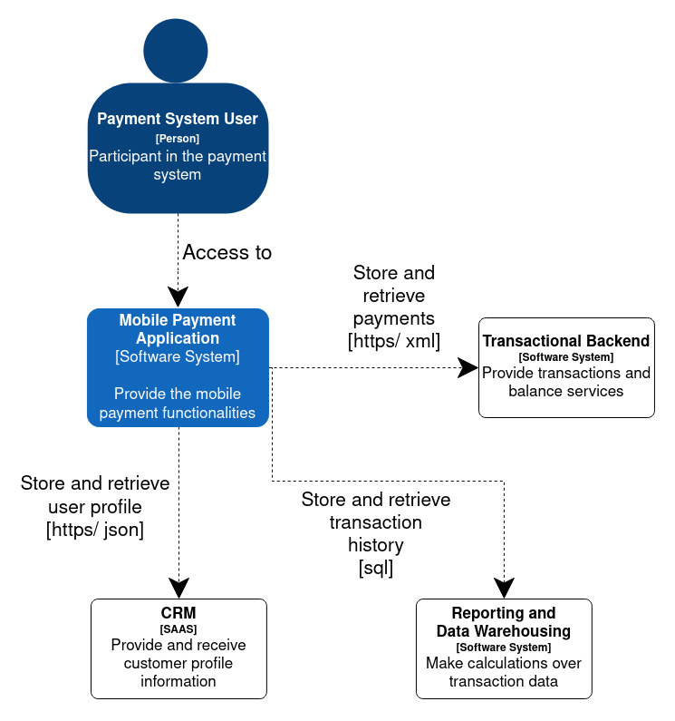
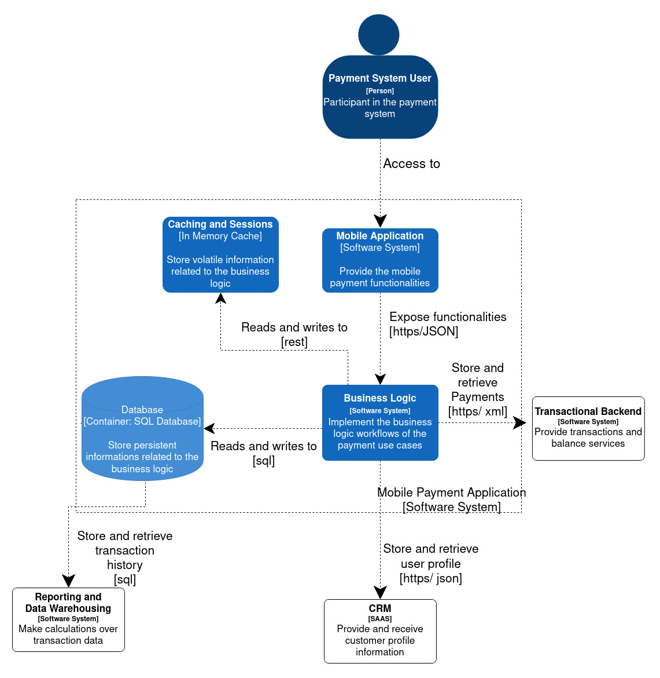
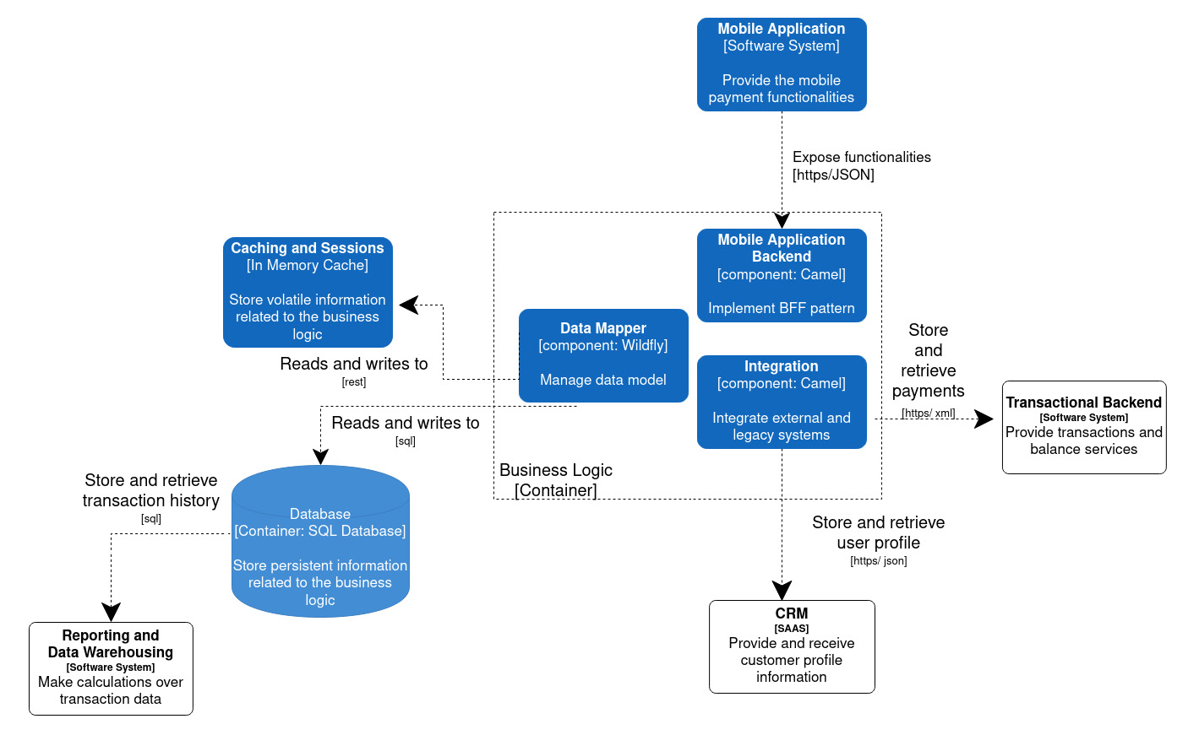
C4 Context Diagram
Examples:
C4 diagrams
for mobile payment
C4 Container Diagram
C4 Component Diagram

